Slide 1
Restaurant Recommending Chatbot
Week
4
Weekly Report - Group 3
Murali Krishna(C0794253)
Swathi Gurijala(C0790294)
Varadharajan Kalyanaraman(C0793756)
Vignesh Kumar Murugananthan(C0793760)

Slide 2
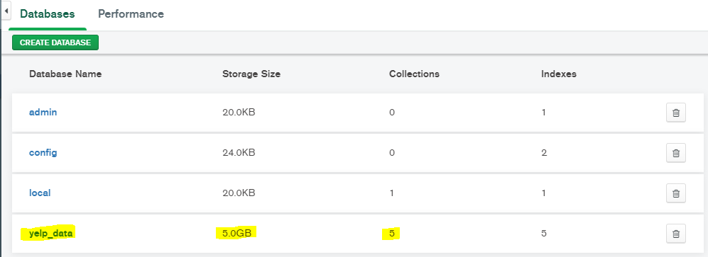
Data Set - Yelp
MongoDB Compass

Slide 3
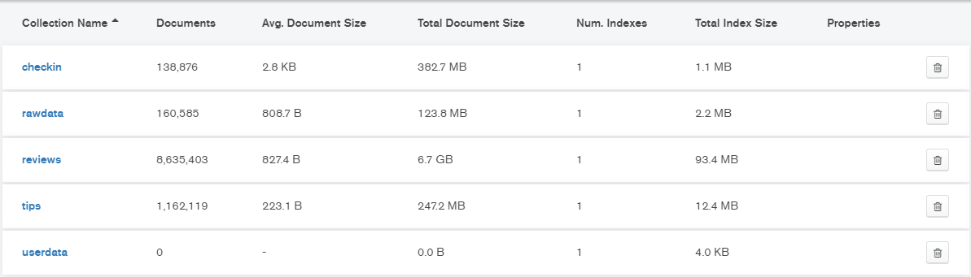
Json Files imported

Slide 4
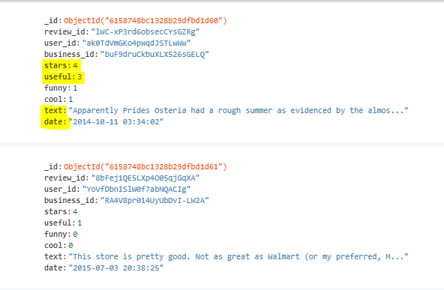
Review data sample

Slide 5
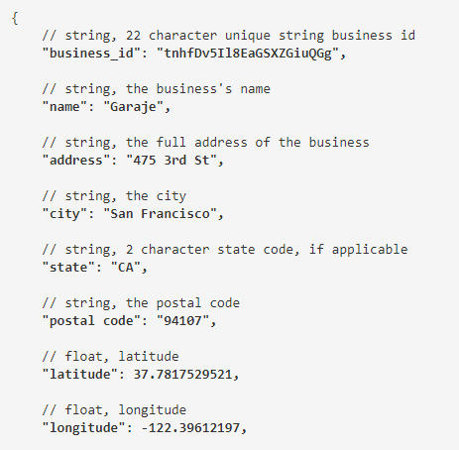

Slide 6
Next week work - Week 4
Perform initial cleaning of data.
Data Preprocessing.
Structure the data.

Slide 7
Restaurant Recommending Chatbot
Week
5
Weekly Report - Group 3
Murali Krishna(C0794253)
Swathi Gurijala(C0790294)
Varadharajan Kalyanaraman(C0793756)
Vignesh Kumar Murugananthan(C0793760)

Slide 8
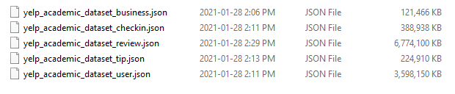
Week 5 - Dataset review :

Slide 9
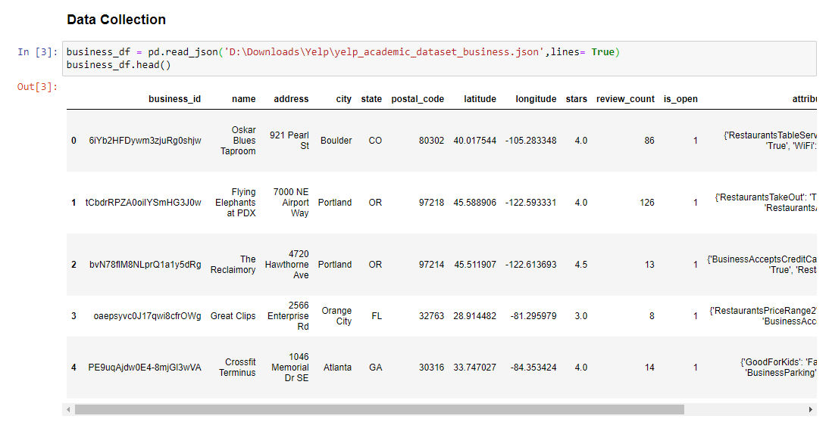
Data Collection : Business Dataset

Slide 10
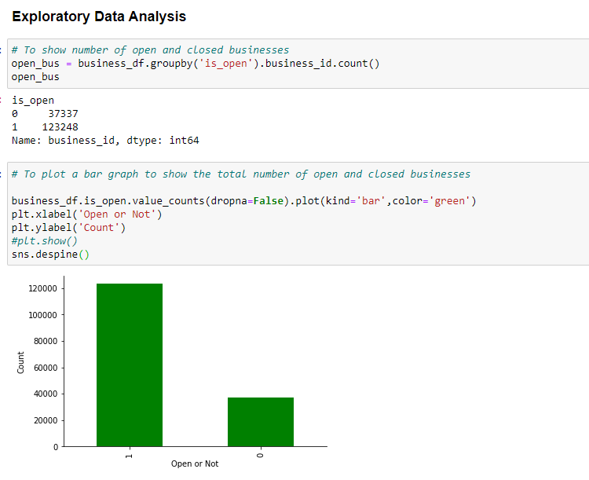
Exploratory Data Analysis

Slide 11
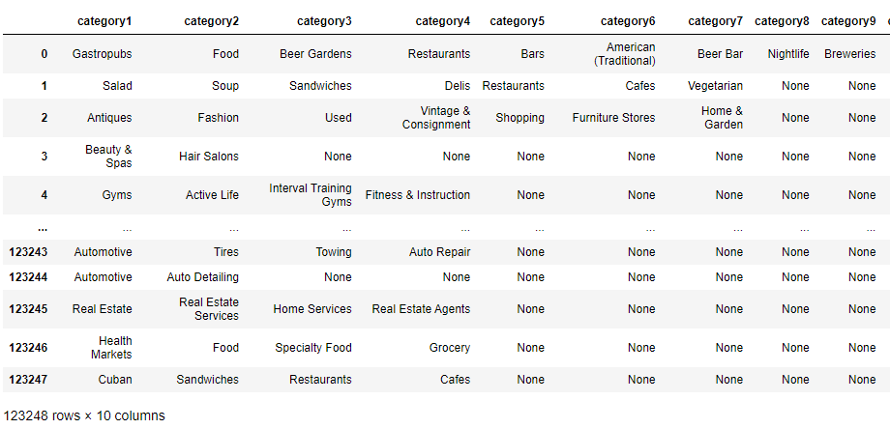
Restaurant Category

Slide 12
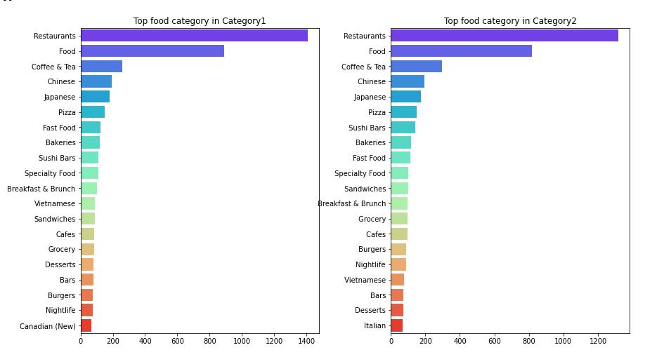
Category 1 vs Category 2

Slide 13
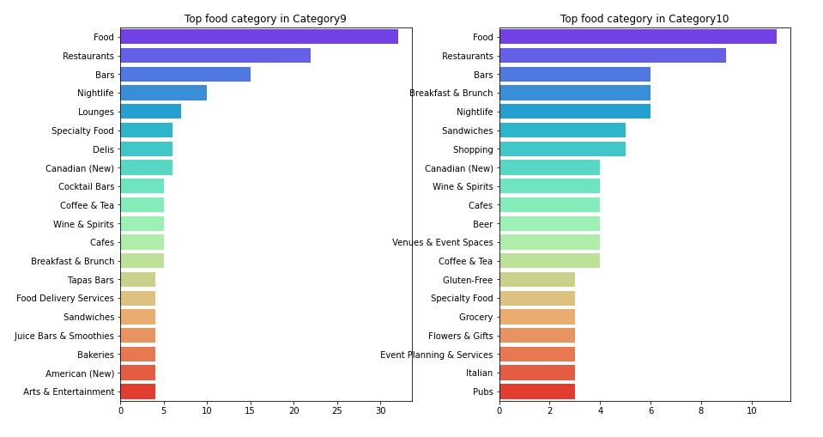
Category 9 vs Category 10

Slide 14
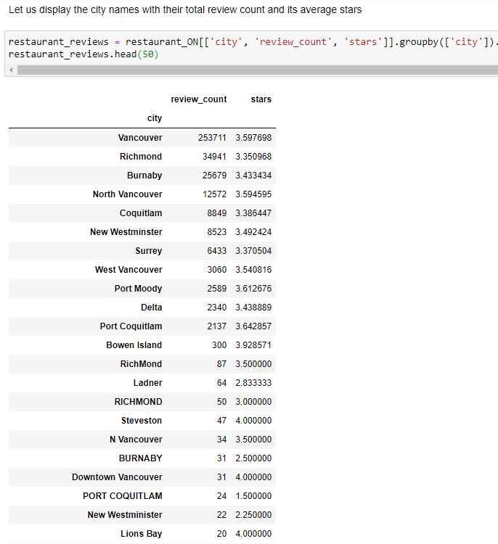
Reviews on each City:

Slide 15
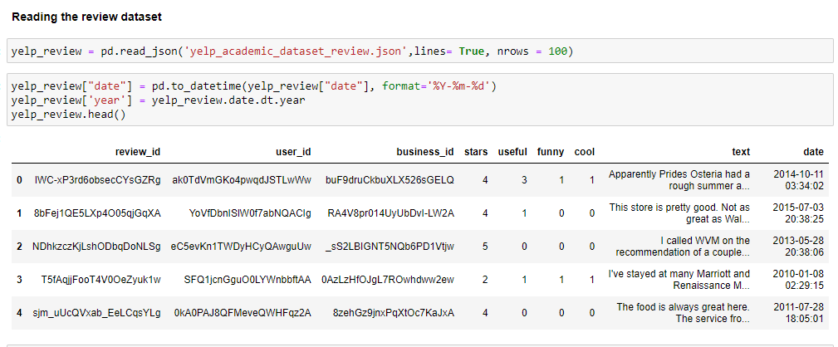
Review Dataset

Slide 16
Upcoming works:
NLP Concepts - Finding the best restaurants for particular cuisines
Modelling
Model Evaluation
Cosine Similarity
Chat bot Building

Slide 17
Thank You

